Slide 1
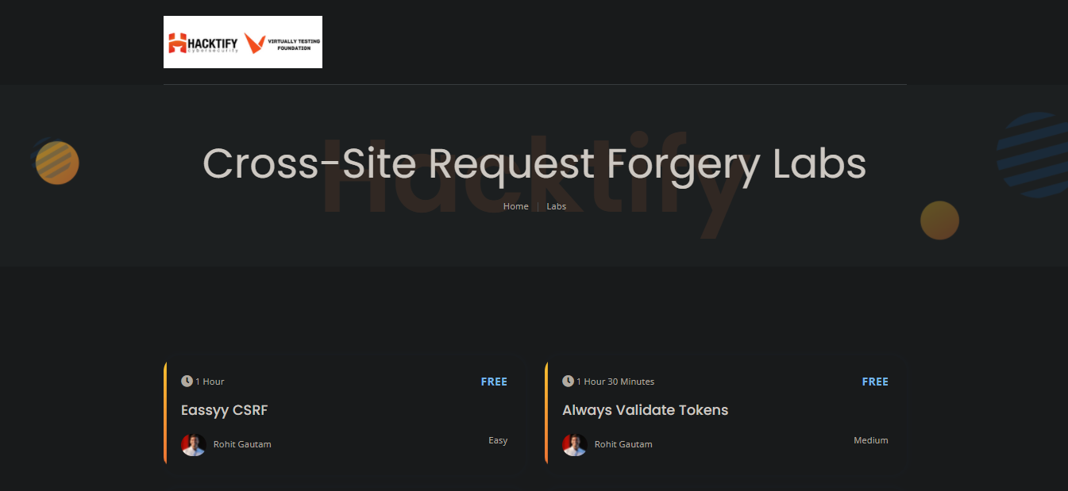
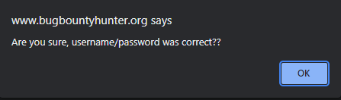

Week 6 as a Penetration Testing Intern
Cross-Site Request Forgery (CSRF)
Exploitation techniques of CSRF
Severity, risks, impact, prevention of CSRF
Hands on practice on CSRF
CSRF
Virtually Testing Foundation

